Slide 1
Finding the n^{th} term
Sequences

Slide 2
how to use Oak lessons

Slide 3
I can find the n^{th} term by investigating the common difference.

Slide 4
The n^{th} term of a sequence is the position of a term in a sequence where n stands for the term number. For example, if n = 10 this means the 10th term in the sequence.
Because the n^{th} term can be used to calculate any term in a sequence it is also a formula for finding the n^{th} term.

Slide 5

Finding the n^{th} term
Finding the n^{th} term of increasing sequences
Finding the n^{th} term of decreasing sequences
Finding and using the n^{th} term

Slide 6

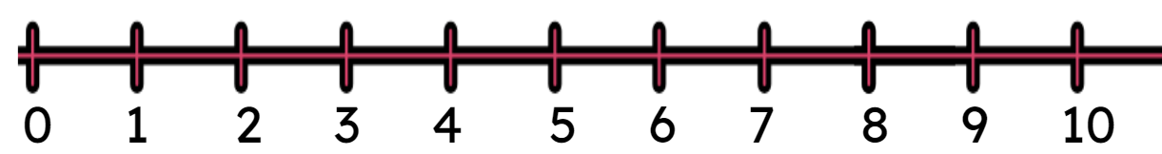
Finding the n^{th} term of increasing sequences
What happens when you add 2 to 5?
5 + 2 = 7
+2
From the position 5, a translation of 2 in the positive direction.

Slide 7
Finding the n^{th} term of increasing sequences
What is the same about the sequences 5n and 5n + 2?
+2
+2
+2
+2
+2
Same:
Both have a common difference of 5
Term by term, what is the difference between the sequences?
There is a difference of 2 between each term.

Slide 8
Finding the n^{th} term of increasing sequences
Why is there a difference of 2 between 5n and 5n + 2?
+2
5n + 2 is a translation of 5n by 2 in the positive direction.

Slide 9
Finding the n^{th} term of increasing sequences
For each sequence describe the translation from 3n.
No translation from 3n or 3n + 0
Translation of 3n by 1 in the positive direction.
Translation of 3n by 2 in the positive direction.
Translation of 3n by 3 in the positive direction.

Slide 10


Finding the n^{th} term of increasing sequences
Find the n^{th} term of the given arithmetic sequence.
We need two things:
+4
The common difference
The translation
+1
+4
+4
+4
+4
+1

Slide 11




Finding the n^{th} term of increasing sequences
Find the n^{th} term without a number line.
Find the n^{th} term without a number line.
Comparing terms with the same term number.
+2
+2
+2
+2
+2
+3
+3
+3
+3
+3
Checking for all of the terms shown.
+6
+6
+6
+6
+5
+5
+5
+5
Common difference: +6
Translation: +2
Common difference: +5
Translation: +3
Common difference
Translation
Common difference
Translation

Slide 12

Finding the n^{th} term of increasing sequences
Corresponding terms in the sequence 8n − 5 will be a translation by how much from terms in the sequence 8n?
5
The sequence 8n begins 8, 16, 24, 32, ...
−5
The sequence 8n - 5 begins 3, 11, 19, 27, … ...
A translation of -5
8

Slide 13


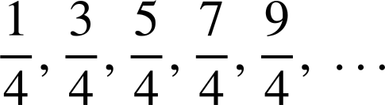
Finding the n^{th} term of increasing sequences
1) Find the n^{th} term of the sequences below:
a)
b)
c)
d)
e)

Slide 14



Finding the n^{th} term of increasing sequences
2) Andeep says:
The sequence -5, -3, -1, 1, 3, … is because the common difference is +2 and it starts at -5
Give two explanations as to why Andeep is wrong.
The number line may help.

Slide 15





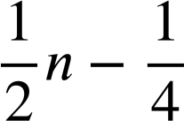


Finding the n^{th} term of increasing sequences
1) Find the n^{th} term of the below sequences:
Common difference: +7
a)
Translation from 7n: +3
Common difference: +7
b)
Translation from 7n: -6
Common difference: +3
c)
Translation from 3n: -13
Common difference: +0.4
d)
Translation from 0.4n: +0.5
Common difference:
e)
Translation from :

Slide 16



Finding the n^{th} term of increasing sequences
2) Andeep says:
The sequence -5, -3, -1, 1, 3, … is because the common difference is +2 and it starts at -5
The sequence 2n starts:
-7
-7
-7
Your sequence is a translation by -7 therefore it is

Slide 17
Finding the n^{th} term of increasing sequences
2) Andeep says:
The sequence -5, -3, -1, 1, 3, … is because the common difference is +2 and it starts at -5
The sequence 2n would be here…
Your sequence is a translation by -7 therefore it is
-7

Slide 18
Finding the n^{th} term of increasing sequences
2) Andeep says:
The sequence -5, -3, -1, 1, 3, … is because the common difference is +2 and it starts at -5
n = 1
2(1) - 5 = -3
The first term of the sequence is -3 whereas your first term is -5 so can not describe your sequence.

Slide 19
Finding the n^{th} term
Finding the n^{th} term of increasing sequences
Finding the n^{th} term of decreasing sequences
Finding and using the n^{th} term

Slide 20
Finding the n^{th} term of decreasing sequences
Let’s compare these two sequences.
10 + 2n is increasing by 2 each time.
10 − 2n is decreasing by 2 each time.
What do you notice?

Slide 21
Finding the n^{th} term of decreasing sequences
Let’s compare these two sequences.
n = 1 10 + 2(1) = 10 + 2 = 12
n = 1 10 - 2(1) = 10 - 2 = 8
n = 2 10 + 2(2) = 10 + 4 = 14
n = 2 10 - 2(2) = 10 - 4 = 6
n = 3 10 + 2(3) = 10 + 6 = 16
n = 3 10 - 2(3) = 10 - 6 = 4
As the sequence grows we add more and more lots of positive 2
As the sequence grows we add more and more lots of negative 2
A positive coefficient of n gives us an increasing sequence.
A negative coefficient of n gives us a decreasing sequence.

Slide 22






Finding the n^{th} term of decreasing sequences
Which of these arithmetic sequences is a decreasing sequence?
+8 coefficient of n. Increasing sequence.
+3 coefficient of n. Increasing sequence.
-8 coefficient of n. Decreasing sequence.
-3 coefficient of n. Decreasing sequence.

Slide 23




Finding the n^{th} term of decreasing sequences
Find the term.
Find the term.
-0.05
-0.05
-0.05
-0.05
-0.05
-1.95
-1.95
-1.95
-1.95
-1.95
-0.03
-0.03
-0.03
-0.03
-0.15
-0.15
-0.15
-0.15
Common difference: -0.03
Translation of -0.03n: -0.05
Common difference: -0.15
Translation of -0.15n: -1.95
Translation
Common difference
Common difference
Translation

Slide 24





Finding the n^{th} term of decreasing sequences
1) Match the sequences to their n^{th} terms.

Slide 25

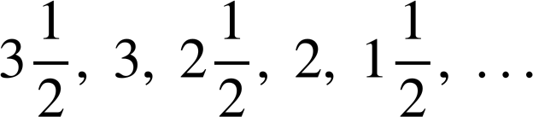
Finding the n^{th} term of decreasing sequences
2) Find the n^{th} term of these sequences.
a)
b)
c)
d)
e)
f)

Slide 26


Finding the n^{th} term of decreasing sequences
3) Two students are discussing arithmetic sequences.
You’re right Aisha! If we had 30 and 25 we’d know it’s 30, 25, 20, 15, 10, … with an n^{th} term of 35 - 5n
If you give me any two terms of an arithmetic sequence I can tell you the n^{th} term.
Aisha
Sofia
Write a sentence to explain if Aisha and Sofia are right.

Slide 27
Finding the n^{th} term of decreasing sequences
1) Match the sequences to their n^{th} terms.

Slide 28





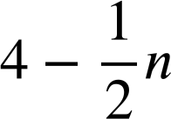
Finding the n^{th} term of decreasing sequences
2) Find the n^{th} term of these sequences.
a)
b)
c)
d)
e)
f)

Slide 29
Finding the n^{th} term of decreasing sequences
3) Two students are discussing arithmetic sequences.
You’re right Aisha! If we had 30 and 25 we’d know it’s 30, 25, 20, 15, 10, … with an n^{th} term of 35 - 5n
If you give me any two terms of an arithmetic sequence I can tell you the n^{th} term.
You might have written:
You need to know which two terms you have. If 30 and 25 are terms one and two then yes, it’s 35 - 5n.
But, if 30 and 25 are the fifth and sixth terms, then it’s a different sequence altogether.
Aisha
Sofia

Slide 30
Finding the n^{th} term
Finding the n^{th} term of increasing sequences
Finding the n^{th} term of decreasing sequences
Finding and using the n^{th} term

Slide 31
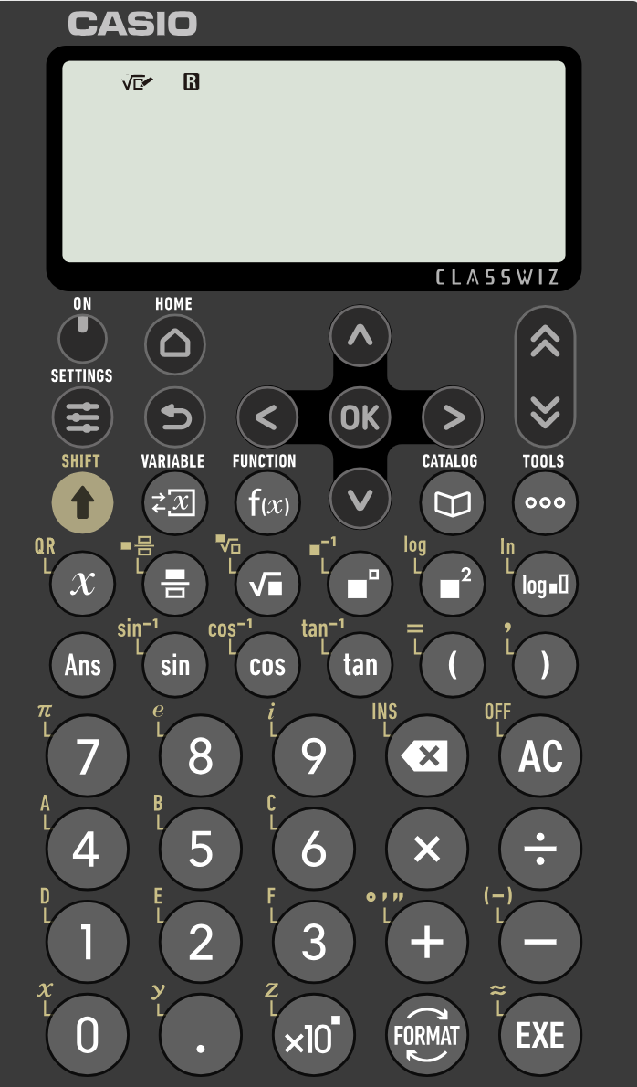
Finding and using the n^{th} term
An arithmetic sequence starts with the terms:
89.625, 89.275, 88.925, 88.575, 88.225, …
When will it reach 21.025?
For this one we need to use a calculator

Slide 32
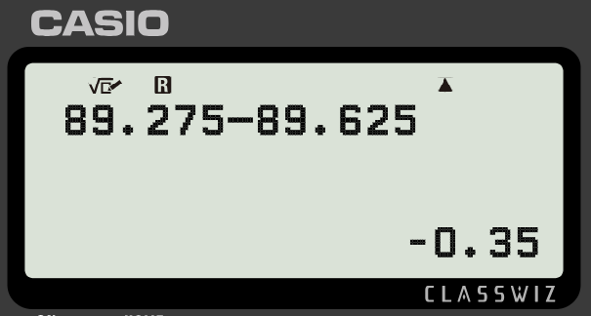
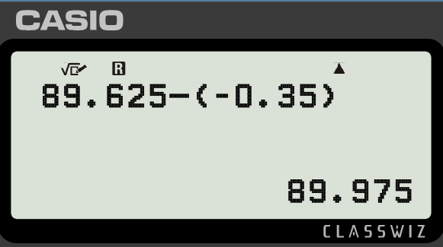

Finding and using the n^{th} term
Firstly we need the n^{th} term.
89.625, 89.275, 88.925, 88.575, 88.225, …
Common difference: -0.35
Translation: +89.975

Slide 33
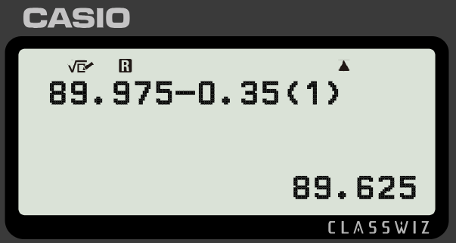

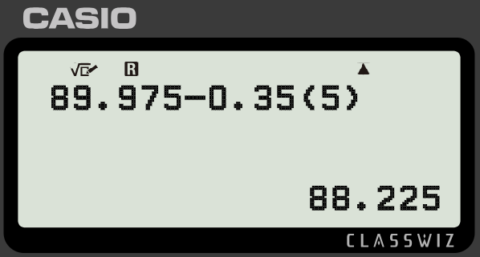


Finding and using the n^{th} term
Quick test to check that is our n^{th} term.
89.625, 89.275, 88.925, 88.575, 88.225, …
Use left arrow keys to change the term number.

Slide 34
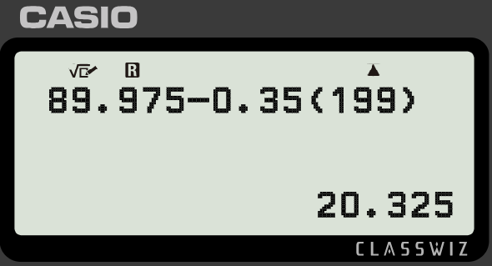


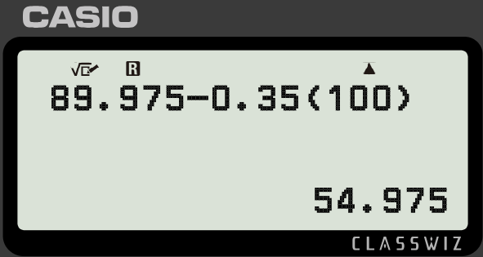
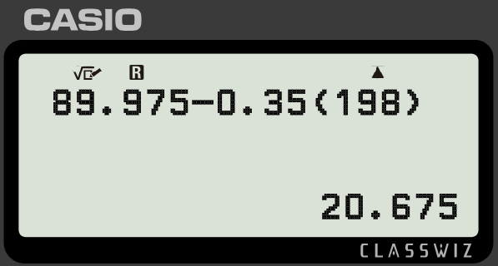




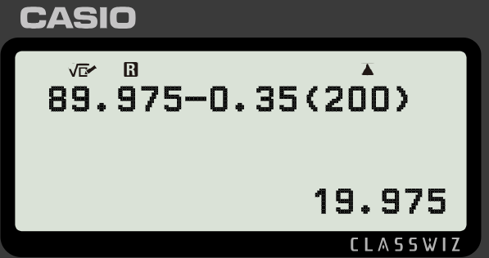
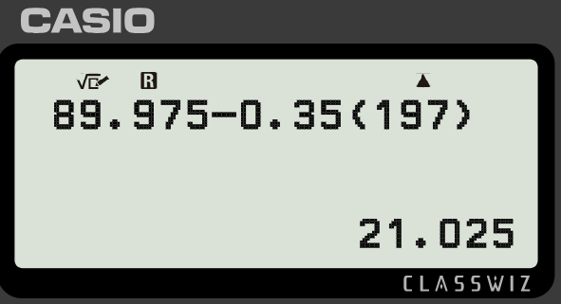

Finding and using the n^{th} term
When will reach 21.025?
Use trial and improvement.
The 197th term

Slide 35

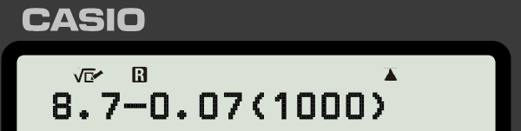
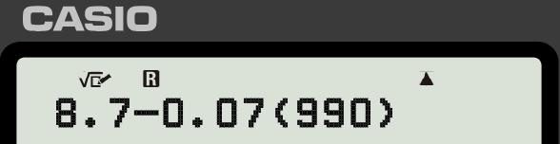
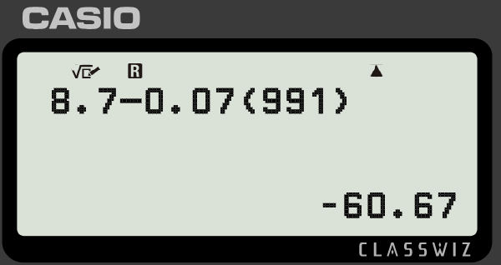
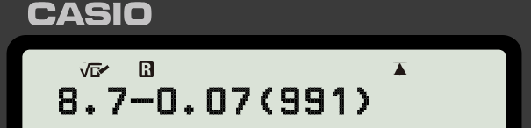
Finding and using the n^{th} term
Which of the below finds the term −60.67 in the sequence ?

Slide 36


Finding and using the n^{th} term
1) Find the n^{th} term, then use approximation and counting on to find the term 705 in the arithmetic sequence starting −25, −15, −5, 5, 15, …
2) Find the n^{th} term, then use approximation and counting on to find the term −554 in the arithmetic sequence starting −2, −14, −26, −38, −50, …
3) Jacob wants to know the last positive term in the sequence . Use trial and improvement on your calculator to help him.

Slide 37

Finding and using the n^{th} term
1) Find the n^{th} term, then use approximation and counting on to find the term 705 in the arithmetic sequence starting −25, −15, −5, 5, 15, …
n = 70 10(70) − 35 = 665
…, 665, 675, 685, 695, 705, …
70th
71st
72nd
73rd
74th
705 is the 74th term in the sequence.

Slide 38

Finding and using the n^{th} term
2) Find the n^{th} term, then use approximation and counting on to find the term −554 in the arithmetic sequence starting −2, −14, −26, −38, −50, …
n = 50 10 − 12(50) = 10 − 600 = −590
…, −554, −566, −578, −590, …
47th
48th
49th
50th
-554 is the 47th term in the sequence.

Slide 39
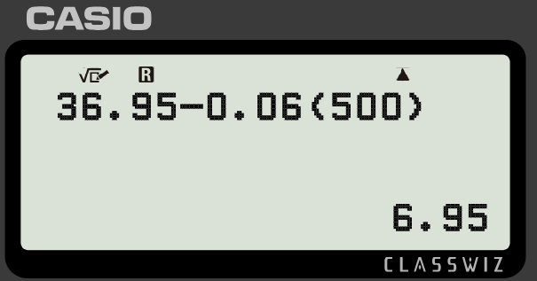
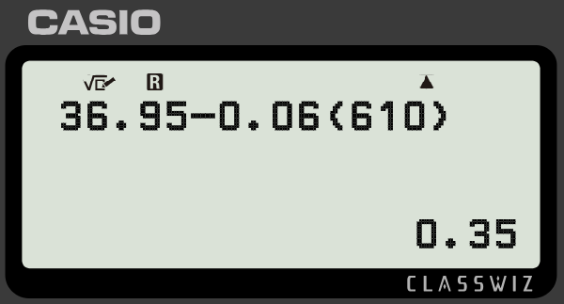
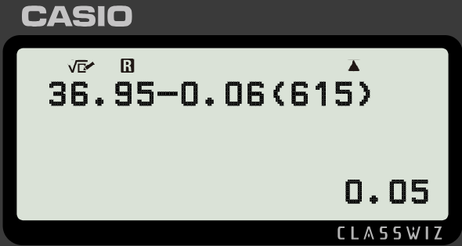
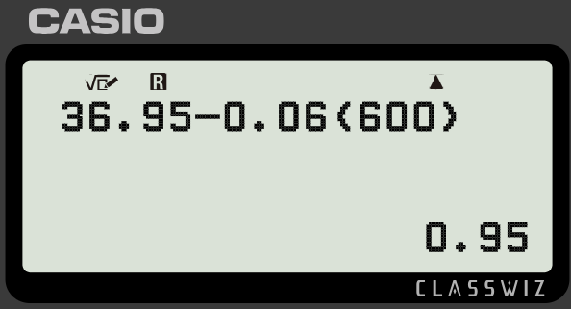
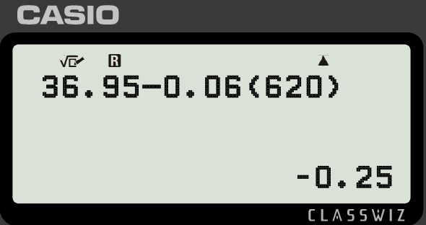
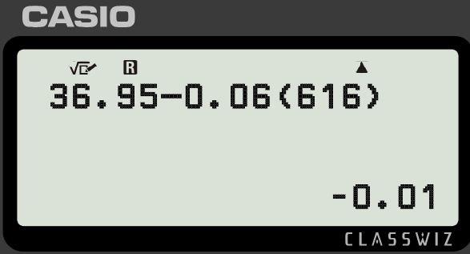
Finding and using the n^{th} term
3) Jacob wants to know the last term positive term in the sequence . Use trial and improvement on your calculator to help him.

Slide 40
Finding and using the n^{th} term
3) Jacob wants to know the last term positive term in the sequence . Use trial and improvement on your calculator to help him.
The 615th term is positive. The 616th term is negative.
Therefore, the 615th is the last positive term.

Slide 41
Finding the n^{th} term
I can find the n^{th} term of an arithmetic sequence by finding the common difference betweens the terms.
E.g. 5, 8, 11, 14, 17…
Has a common difference of 3 therefore is a translation of the sequence with the n^{th} term 3n .
It is a translation of +2 from the sequence 3, 6, 9, 12, … therefore the n^{th} term of the sequence is 3n + 2

Slide 42

© Oak National Academy 2023.
Produced in partnership with Mathematics in Education and Industry.
Licensed on the Open Government Licence v3.0, except where otherwise stated. See Oak terms and conditions.

